Slide 1

Hard Boundary Survey Picks
July 2025

Slide 2
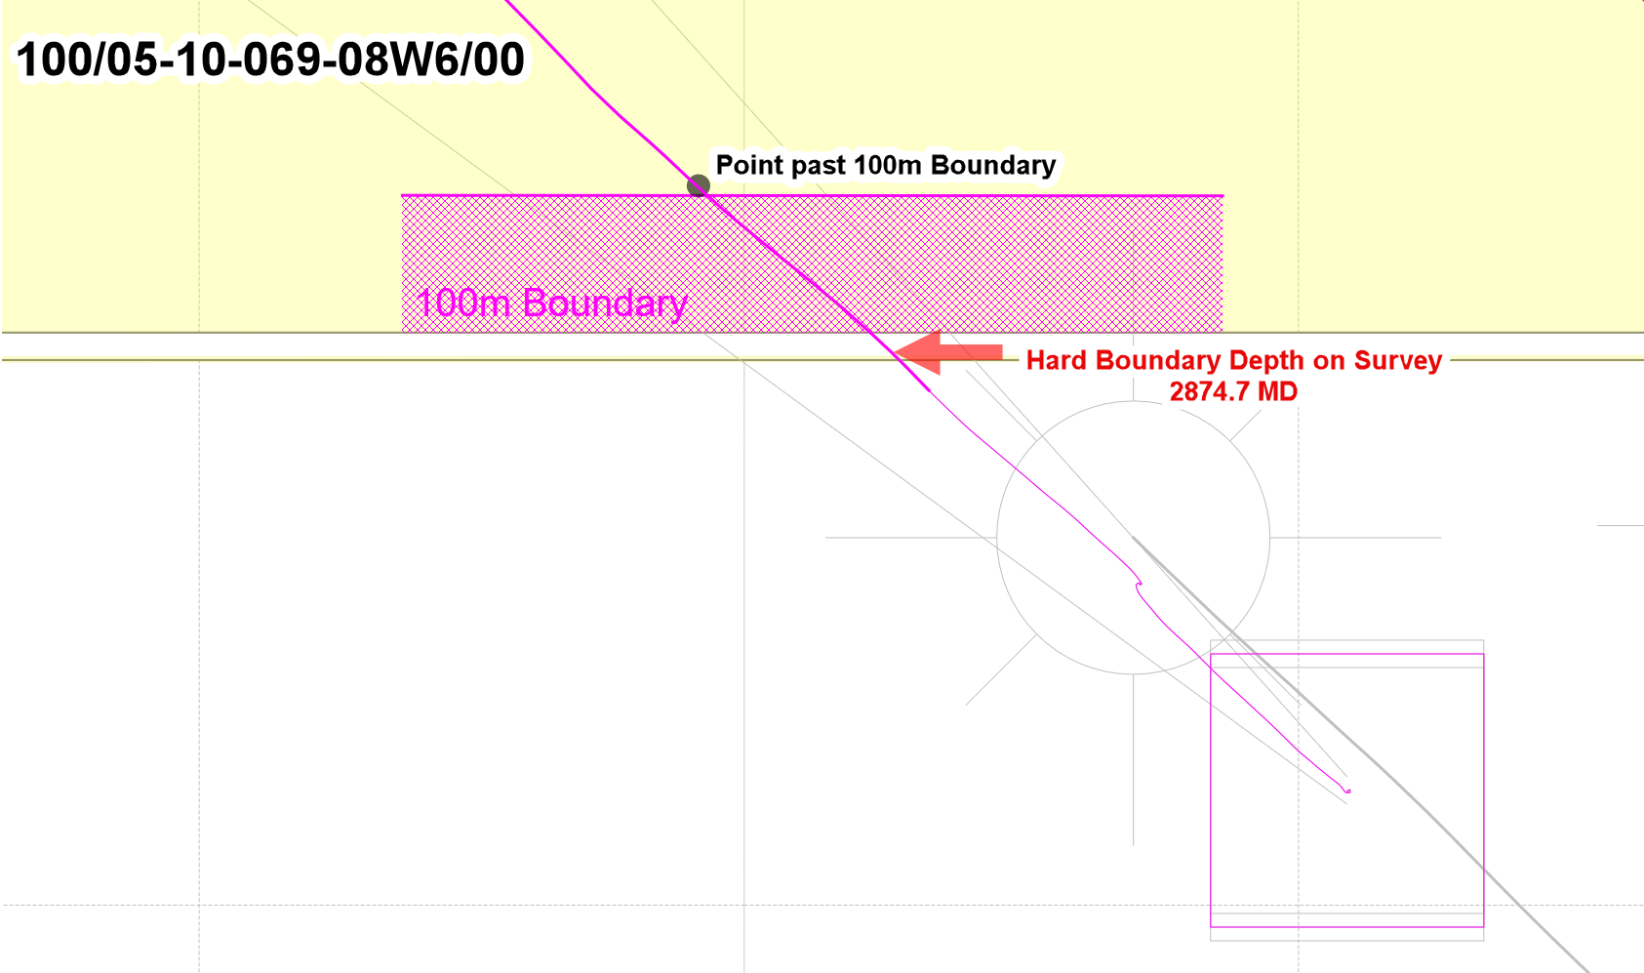
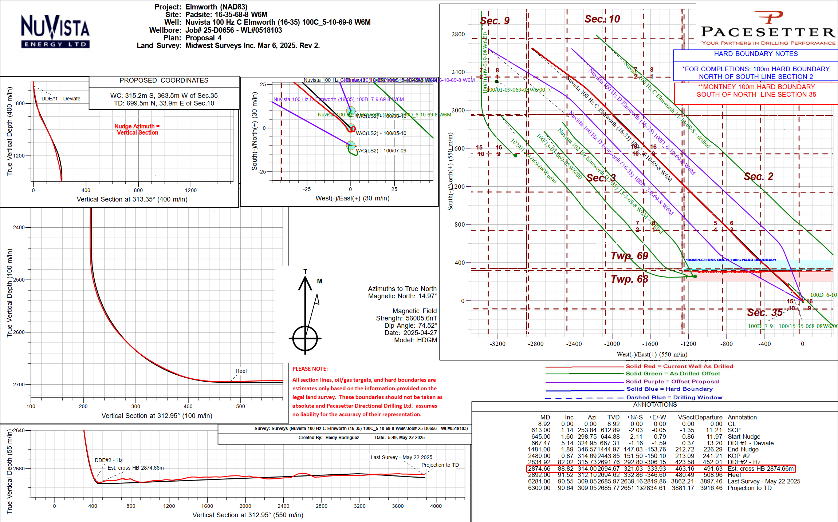
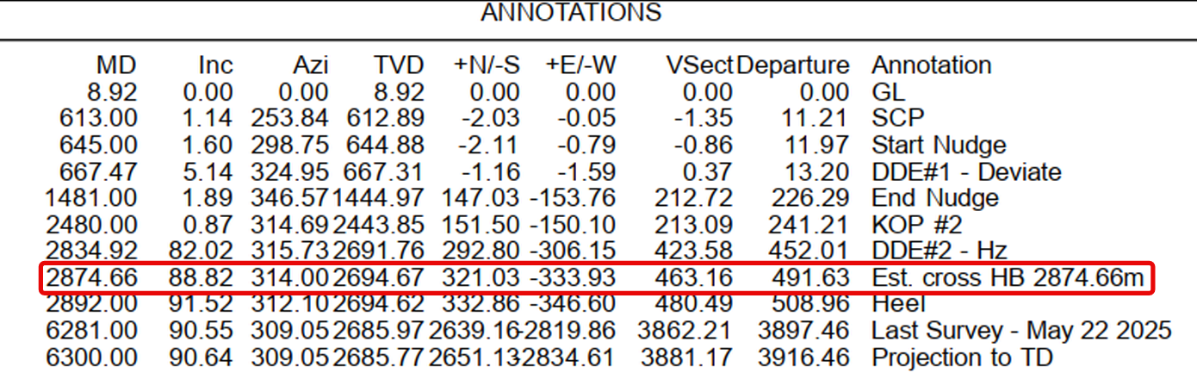
ELM 16-35: 100/05-10-069-08W6

Slide 3
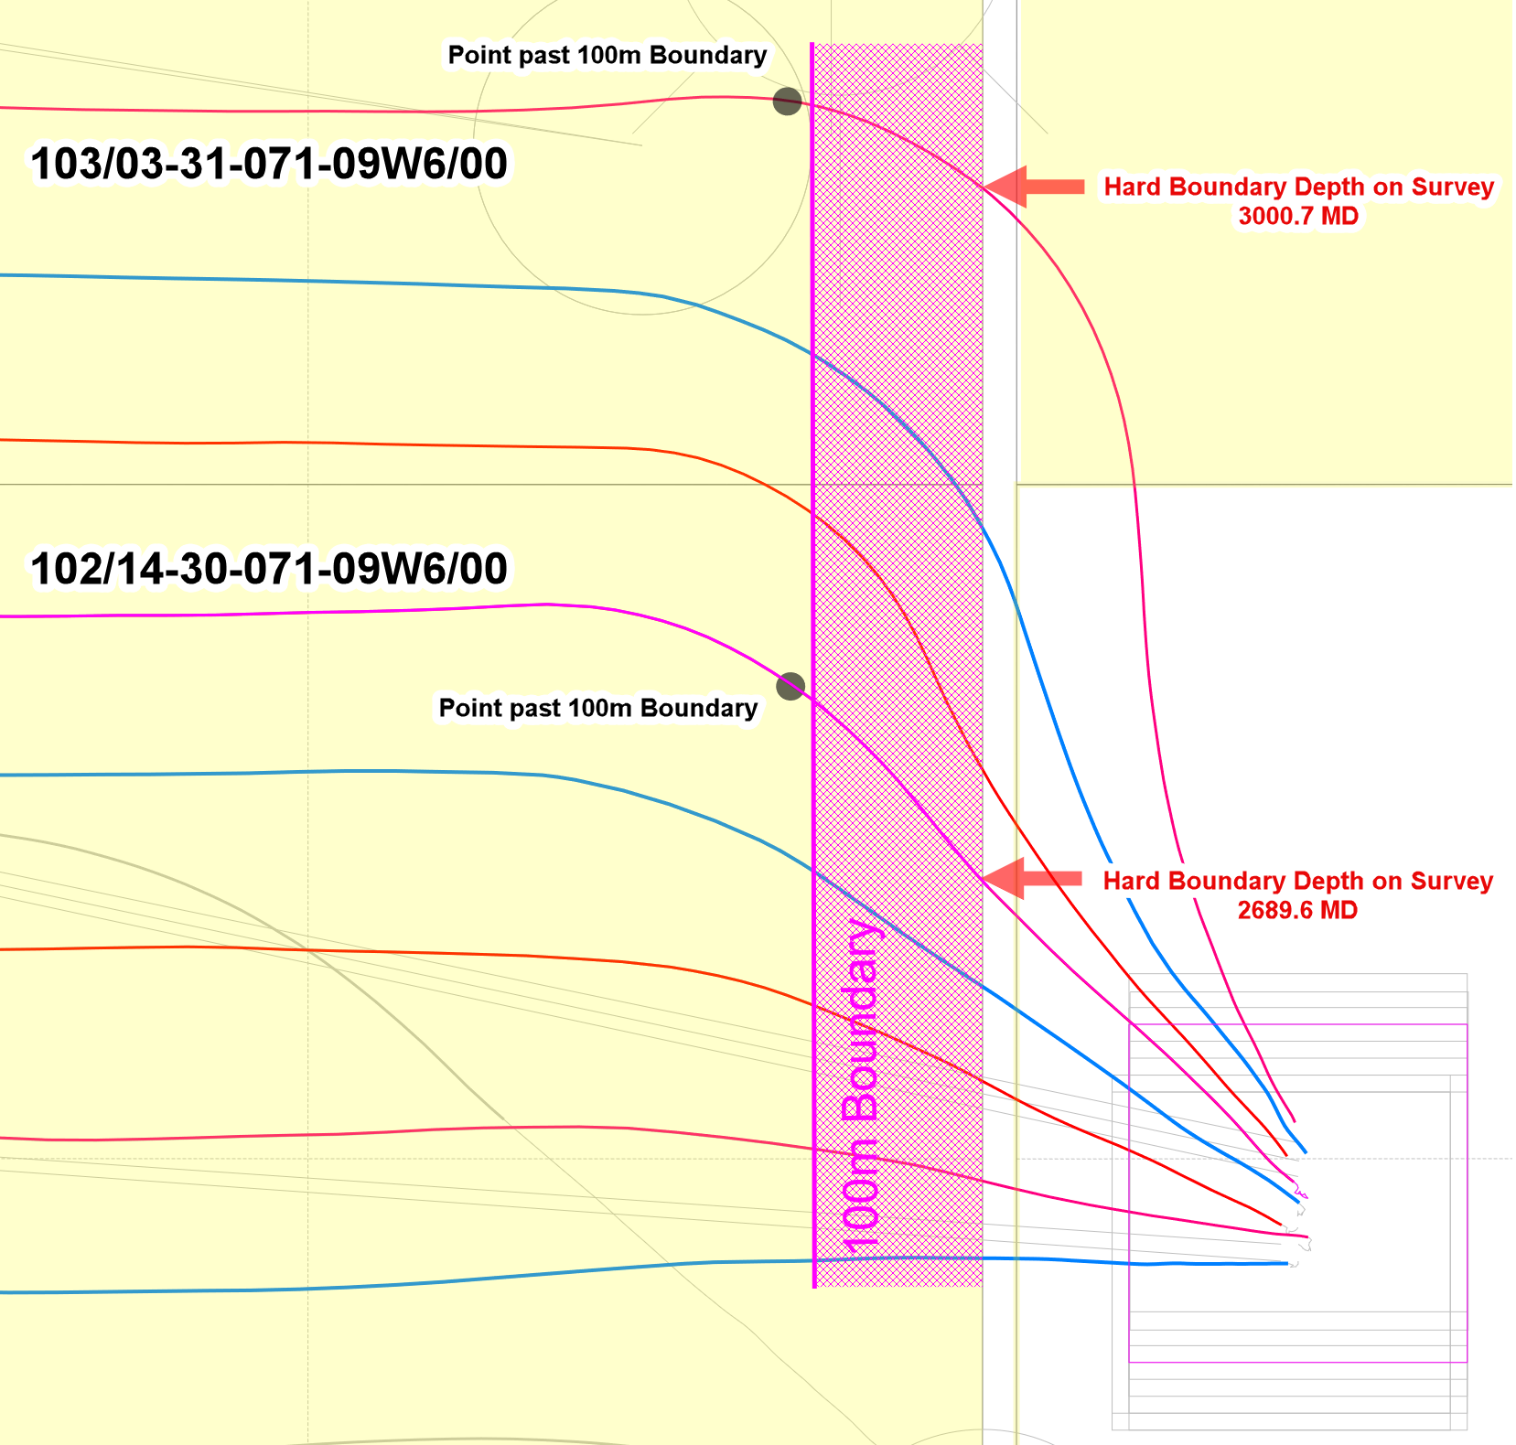
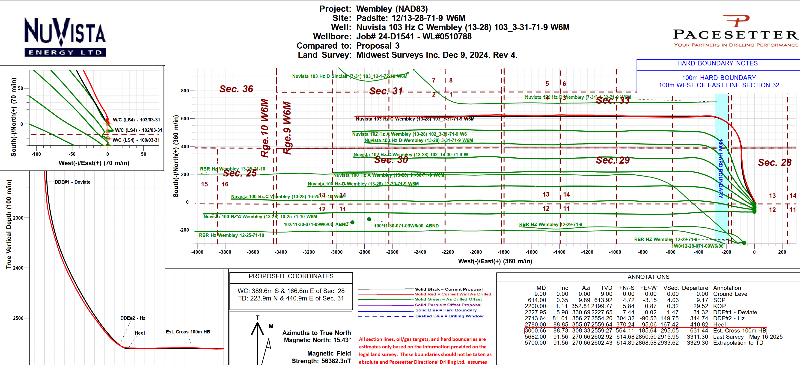
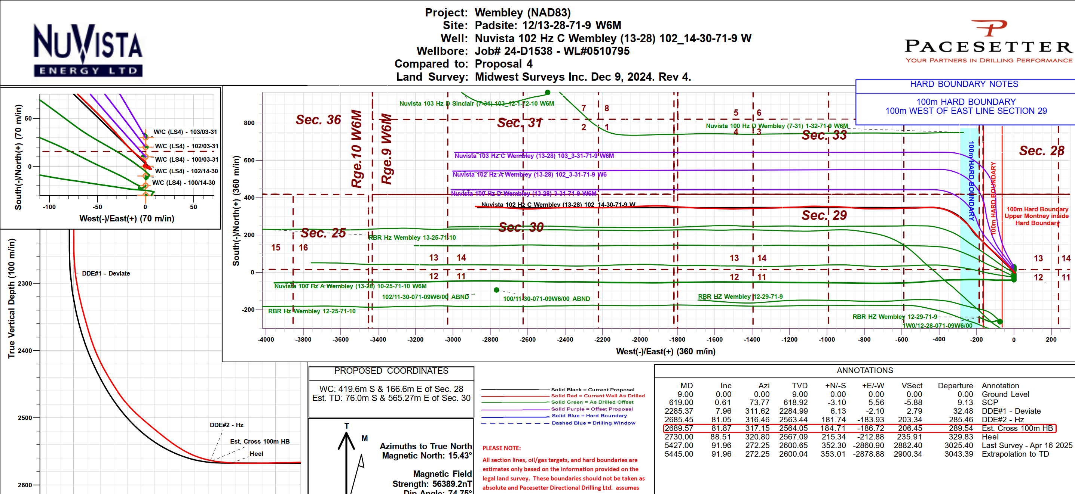
PSN 12-28: 103/03-31-071-09W6 & 102/14-30-071-09W6

